Slide 1
Digital Portfolio
STUDENT NAME: TAMILMARAN P
REGISTER NO AND NMID: 24131050500121045 AND asanm10524131050500121045
DEPARTMENT: BCA
COLLEGE: PERIYAR ARTS COLLEGE CUDDALORE

Slide 2
PROJECT TITLE
Project for showing student
Portfolio

Slide 3


AGENDA
Problem Statement
Project Overview
End Users
Tools and Technologies
Portfolio design and Layout
Features and Functionality
Results and Screenshots
Conclusion
Github Link
3/21/2024 Annual Review

Slide 4

PROBLEM STATEMENT Ressumes in form format are just old style and also it is not so attractive, so instead of presenting resumes in physical foramt it is so attractive to present in a portfolio format..

Slide 5

PROJECT OVERVIEW
*This project is created for storing my achievments or progress
* This portfolio contain my profile, my photo, my details,
My projects, contact info, and my skills..

Slide 6

WHO ARE THE END USERS?
* We students are the end users in here..
because we have created this as a project for our study so we are the end users in this project..
(Note* Those who using the application or operates the application are called end users)

Slide 7

TOOLS AND TECHNIQUES
HTML : I had used html for creating a
good structure for my
project
CSS: The styling techniques that I
used on My project are
based on the css language.
This technique give me a
Good use for coloring..
JS:This scriptual language is used
for adding some
speciallized functions..

Slide 8
POTFOLIO DESIGN AND LAYOUT
* Home
* About me
* Projects
* Skills
* Contacts
* Colourfull layout..
8

Slide 9
FEATURES AND FUNCTIONALITY
Navigation bar has been given
Smooth scrolling..
Projects showcase worth colour
Animation
Contact form..

Slide 10
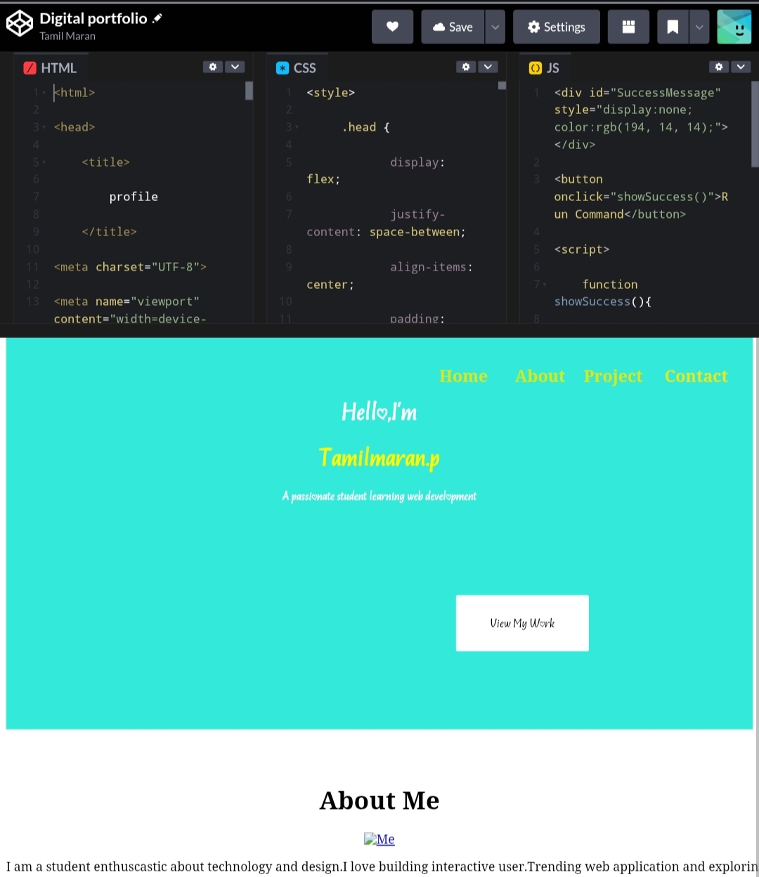

RESULTS AND SCREENSHOTS
The given screen shot will show you my result..
3/21/2024 Annual Review
10

Slide 11
CONCLUSION
The conclusion is the important and need of
having the portfolio ourself will be reflect
in our future...
11

